Slide 1

Database Systems
Course Code: CS-213
Credit Hours: 4(3-1)
Muhammad Ejaz Bashir
Lecturer
Department of Computer Sciences

Slide 2
Content of Lecture
  Database System Deployment
  Database System Components
  Database Application Development Process
  Preliminary Study of System

Slide 3
Database System Deployment
There are three ways to setup the database system in a client/server architecture
All on Same Computer
Multiple Clients, One Server
Multiple Clients, Multiple Servers

Slide 4
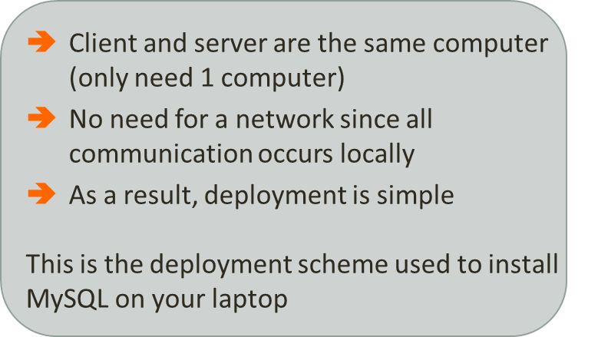
Database System Deployment
All on Same Computer
The client software and server software are both deployed on the same computer
Program
4
1
DBMS
3
2
Database

Slide 5

Database System Deployment
All on Same Computer
The client software and server software are both deployed on the same computer
A client software is a computer program that runs on the client that has the ability to communicate with the server software
E.g. Program that ask DBMS to store/retrieve data is client software
Note: Client is a computer
Client software is a computer program
Software used by client to communicate with the server
Client
DBMS Server
Database

Slide 6

Database System Deployment
All on Same Computer
The client software and server software are both deployed on the same computer
A server software is a computer program that runs on the server that has the ability to communicate with the client software
E.g. DBMS is a server software
Note: Server is a computer
Server software is a computer program
Software used by server to communicate with the client
Program
DBMS
Database

Slide 7

Database System Deployment
All on Same Computer
The client software and server software are both deployed on the same computer
Program
Client software (e.g. program that needs data) sends a data request to server software
4
1
DBMS
3
2
Database

Slide 8

Database System Deployment
All on Same Computer
The client software and server software are both deployed on the same computer
Program
4
1
DBMS
DBMS Server software lookup the data in the database
3
2
Database

Slide 9

Database System Deployment
All on Same Computer
The client software and server software are both deployed on the same computer
Program
4
1
DBMS
3
2
Database
DBMS Server software retrieves data from database

Slide 10

Database System Deployment
All on Same Computer
The client software and server software are both deployed on the same computer
Program
4
1
DBMS
DBMS Server software sends the data response to the client software
3
2
Database

Slide 11
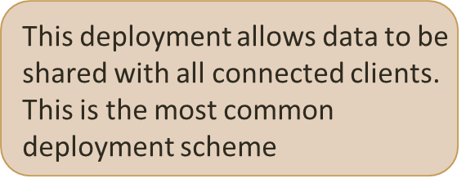
Database System Deployment
Multiple Clients, One Server
Client software running on different computers share a server software running on a remote computer
Program
1
2
Network
DBMS
6
5
Program
Database
4
3

Slide 12

Database System Deployment
Multiple Clients, One Server
Client software sends a data request to the DBMS Server software through the network
Client software running on different computers share a server software running on a remote computer
Program
1
2
Network
DBMS
6
5
Program
Database
4
3

Slide 13

Database System Deployment
Multiple Clients, One Server
DBMS Server software receives data request through the network
Client software running on different computers share a server software running on a remote computer
Program
1
2
Network
DBMS
6
5
Program
Database
4
3

Slide 14

Database System Deployment
Multiple Clients, One Server
Client software running on different computers share a server software running on a remote computer
Program
1
2
Network
DBMS
6
5
DBMS Server software lookup data in the database
Program
Database
4
3

Slide 15

Database System Deployment
Multiple Clients, One Server
Client software running on different computers share a server software running on a remote computer
Program
1
2
Network
DBMS
6
5
DBMS Server software retrieve data from database
Program
Database
4
3

Slide 16

Database System Deployment
Multiple Clients, One Server
Client software running on different computers share a server software running on a remote computer
Program
1
2
Network
DBMS
6
5
Program
DBMS Server software sends data response to client software through the network
Database
4
3

Slide 17

Database System Deployment
Multiple Clients, One Server
Client software running on different computers share a server software running on a remote computer
Program
1
2
Network
DBMS
6
5
Program
Client software receives data response through the network
Database
4
3
Click on the numbered boxes for explanation

Slide 18
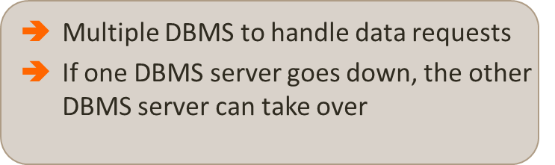
Database System Deployment
Multiple Clients, Multiple Servers
This is similar to “Multiple Clients, One server” except with multiple server software deployments
DBMS
Program
Network
Database
Program
Program
DBMS
Program
Database

Slide 19
Database System Components
Input to DBMS
Programs
SQL Queries
Database schemas
DBMS
DML preprocessor
Query processor
DDL compiler
Program object code
Database manager
Dictionary manager
Access methods
File manager
Database
System buffers

Slide 20
Database System Components
Input to DBMS
Programs
SQL Queries
Database schemas
DBMS
DML preprocessor
Query processor
DDL compiler
Program object code
Database manager
Dictionary manager
Access methods
File manager
Database
System buffers

Slide 21

Database System Components
Input to DBMS
Programs
SQL Queries
Database schemas
DBMS
DML preprocessor
Query processor
DDL compiler
Programs can communicate with the DBMS through the provided application programming interfaces (APIs). Programs therefore can ask the DBMS to perform data storage and retrieval
Program object code
Database manager
Dictionary manager
Access methods
File manager
Database
System buffers

Slide 22

Database System Components
Input to DBMS
Programs
SQL Queries
Database schemas
DBMS
DML preprocessor
Query processor
DDL compiler
Program object code
Database manager
Dictionary manager
Data Manipulation Languages (DML)
This module converts statements for manipulating data (i.e. DML statements) that are embedded in programs into instructions that the DBMS understands
Access methods
File manager
Database
System buffers

Slide 23

Database System Components
Input to DBMS
Programs
SQL Queries
Database schemas
DBMS
DML preprocessor
Query processor
DDL compiler
SQL queries are instructions to the DBMS to perform data storage and retrieval
e.g. SELECT * FROM STUDENT
Program object code
Database manager
Dictionary manager
Access methods
File manager
Database
System buffers

Slide 24

Database System Components
Input to DBMS
Programs
SQL Queries
Database schemas
DBMS
DML preprocessor
Query processor
DDL compiler
Program object code
Database manager
Dictionary manager
This is a major DBMS component that transforms SQL queries into a series of low-level instructions directed to the Database manager
Access methods
File manager
Database
System buffers

Slide 25

Database System Components
Input to DBMS
Programs
SQL Queries
Database schemas
DBMS
DML preprocessor
Query processor
DDL compiler
Program object code
Database manager
Dictionary manager
The module examines the external and conceptual schemas to determine what is required to satisfy the SQL query. The Database manager then places a call to the File manager to execute the query
Access methods
File manager
Database
System buffers

Slide 26

Database System Components
Input to DBMS
Programs
SQL Queries
Database schemas
DBMS
DML preprocessor
Query processor
DDL compiler
This module manipulates the underlying storage files (i.e. files where the data are stored) and manages the allocation of storage space on disk for database data
Program object code
Database manager
Dictionary manager
Access methods
File manager
Database
System buffers

Slide 27

Database System Components
Input to DBMS
Programs
SQL Queries
Database schemas
DBMS
DML preprocessor
Query processor
DDL compiler
Database schemas are the metadata
Program object code
Database manager
Dictionary manager
Access methods
File manager
Database
System buffers

Slide 28

Database System Components
Input to DBMS
Programs
SQL Queries
Database schemas
DBMS
DML preprocessor
Query processor
DDL compiler
Program object code
Database manager
Dictionary manager
Data Definition Language (DDL)
This module converts statements concerning metadata (i.e. DDL statements) into tables to be stored into the system catalogue (i.e. storage for metadata)
Access methods
File manager
Database
System buffers

Slide 29

Database System Components
Input to DBMS
Programs
SQL Queries
Database schemas
DBMS
DML preprocessor
Query processor
DDL compiler
Program object code
Database manager
Dictionary manager
Access methods
File manager
This module maintains and manages access to the system catalogue
Database
System buffers

Slide 30
Database Application Development Process
It Involves
  Database Design
  Application Programs
  Implementation

Slide 31
Database Design
A DB Design is a model of a particular real-world system
It provides a picture of reality
Should be simple and self-explanatory

Slide 32
Database Development Process

Slide 33
Database Development Process
Similar to software development process
Preliminary Study
Requirement Analysis
DB Design
Physical Design
Implementation
Maintenance

Slide 34
Detailed Diagram
Analyze User Environment
Develop Conceptual Model
Map Conceptual Model to Logical
Choose DBMS
Develop Physical Design
Implement System
Test System
Operational Maintenance

Slide 35
Tool Used
Data Flow Diagrams

Slide 36
Data Flow Diagrams

Slide 37
Data Flow Diagrams (DFDs)
Represent the flow of data between different processes within a system
Simple & intuitive, not focusing on details
To describe, what users do, rather than what computers do

Slide 38
Data Flow Diagrams
Limitations
  Focus only on flows of information
  Decision points/basis not included

Slide 39
DFD-Symbols
Data flows: pipelines through which packets of information flow. Arrows are labeled with name of the data that moves through

Slide 40
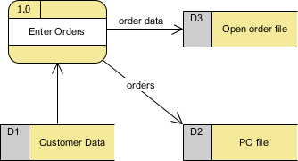
DFD-Symbols
Data Store
Data can be written into a data store, represented by a flow connector flowing from the 'writer' of the data to the data store.
Data can be read from a data store, represented by a flow connector flowing from the data store to the 'reader' of the data.
Examples of data stores include Inventory, Accounts Receivable, Orders, and Daily Payments.

Slide 41

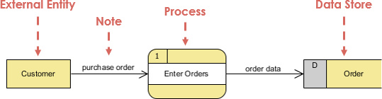
DFD-Symbols
Process
Transforms incoming data flow into outgoing data flow
A rounded rectangle represents a process
Processes are given IDs for easy referencing

Slide 42


DFD-Symbols
External Entities
A rectangle represents an external entity
They either supply data or receive data
They do not process data
A customer submits an order and then receives a bill from the system
A vendor issued an invoice

Slide 43
DFD-Symbols
Collector
Several data flows combine here
No processing occurs here
Separator
Several data flows split here
No processing occurs here

Slide 44
DFD-Symbols
  Ring-sum operator
Shows two possible data flows
Only one is followed
AND operator
Shows two data flows
Both are followed

Slide 45
Types of DFD
Context diagram
Level 0 diagram
Level 1 & 2 diagram (Self-Study)

Slide 46
Context Diagram
Consists of single Process/System
Represents the system/process being analyzed
Name: Usually a Noun phrase

Slide 47
Context Diagram
Show Context Only
Inputs/outputs
External Entities
No Data Stores
No flows between external entities

Slide 48
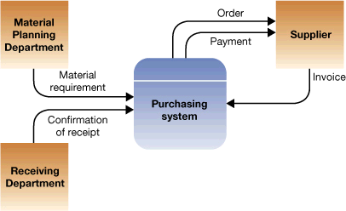
Context Diagram

Slide 49
Context Diagram
Student
Dean
Class Counts
Class Requests
Faculty Load Sheets
Schedule
Admission
System
Course Offerings
Class Lists
Student Data
Registrar
Faculty
Member

Slide 50
Level 0 Diagram
Class
Requests
1.0
Process
Requests
Old Class Data
Class
Registration
Student
C
Request
Status
Updated
Class Data
2.0
Produce
Student
Schedule
Updated
Student
Data
7.0
Produce
Faculty
Load
Sheets
Student
Registration
S
5.0
Produce
Class
Lists
6.0
Produce
Class
Counts
3.0
Create
Student
File
4.0
Create
Class
File
Student
Data
Faculty
member
Registrar
Course
Offering
Dean

Slide 51
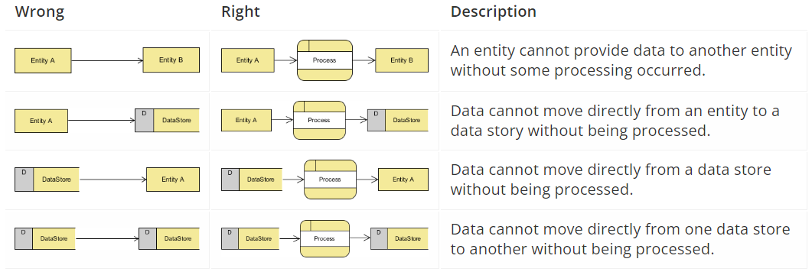
Rule of Data Flow

Slide 52
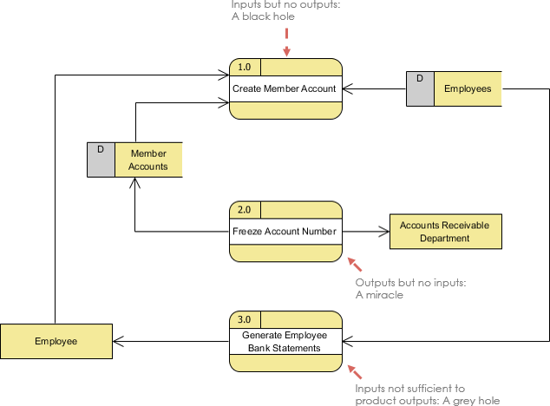
Other frequently made mistakes in DFD
Black holes - A processing step may have input flows but no output flows.
Miracles - A processing step may have output flows but no input flows.
Grey holes - A processing step may have outputs that are greater than the sum of its inputs

Slide 53



